Slide 1
METHODS FOR TRANSCRIBING HANDWRITING IN IMAGES FOR HISTORICAL RESEARCH
Prepared for UMBC Data Science Master Degree Capstone by Dr Chaojie (Jay) Wang
Miriam Schoenbaum
8/4/2026

Slide 2
Origin of project
The Boyds Historical Society owns and has photographed a 464-page handwritten store ledger for the general store in Boyds, Maryland, in 1904-1906.
This handwritten historical document will be more accessible for research and general use if it is transcribed.
Heritage Montgomery awarded $2,500 to the Boyds Historical Society for automated transcription of the document using the text recognition and image analysis platform Transkribus.

Slide 3
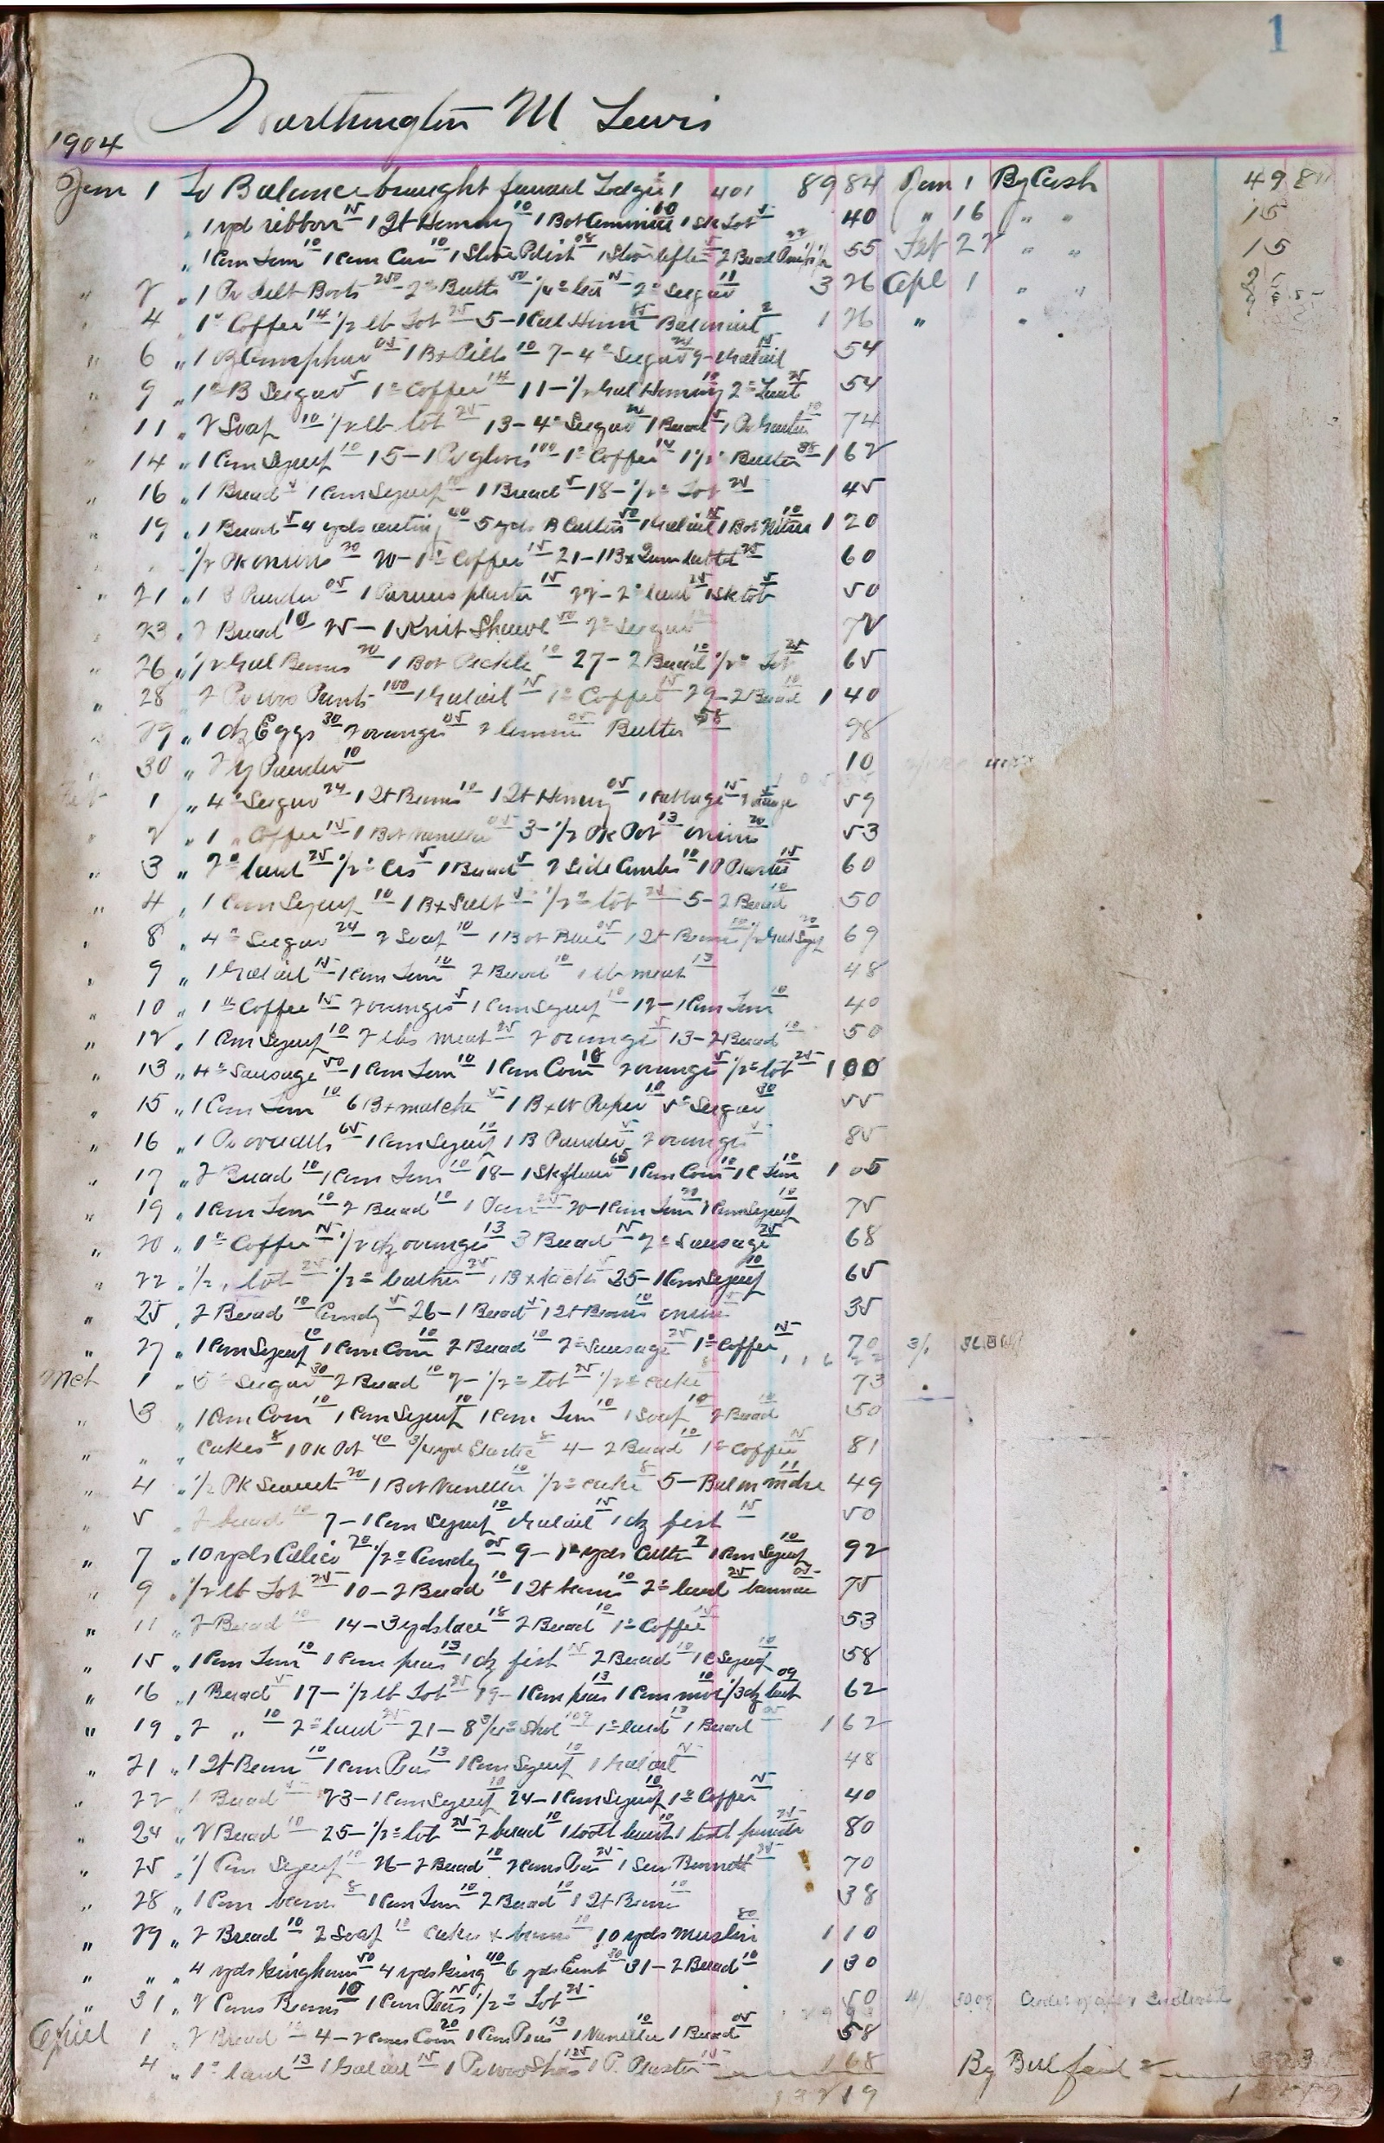
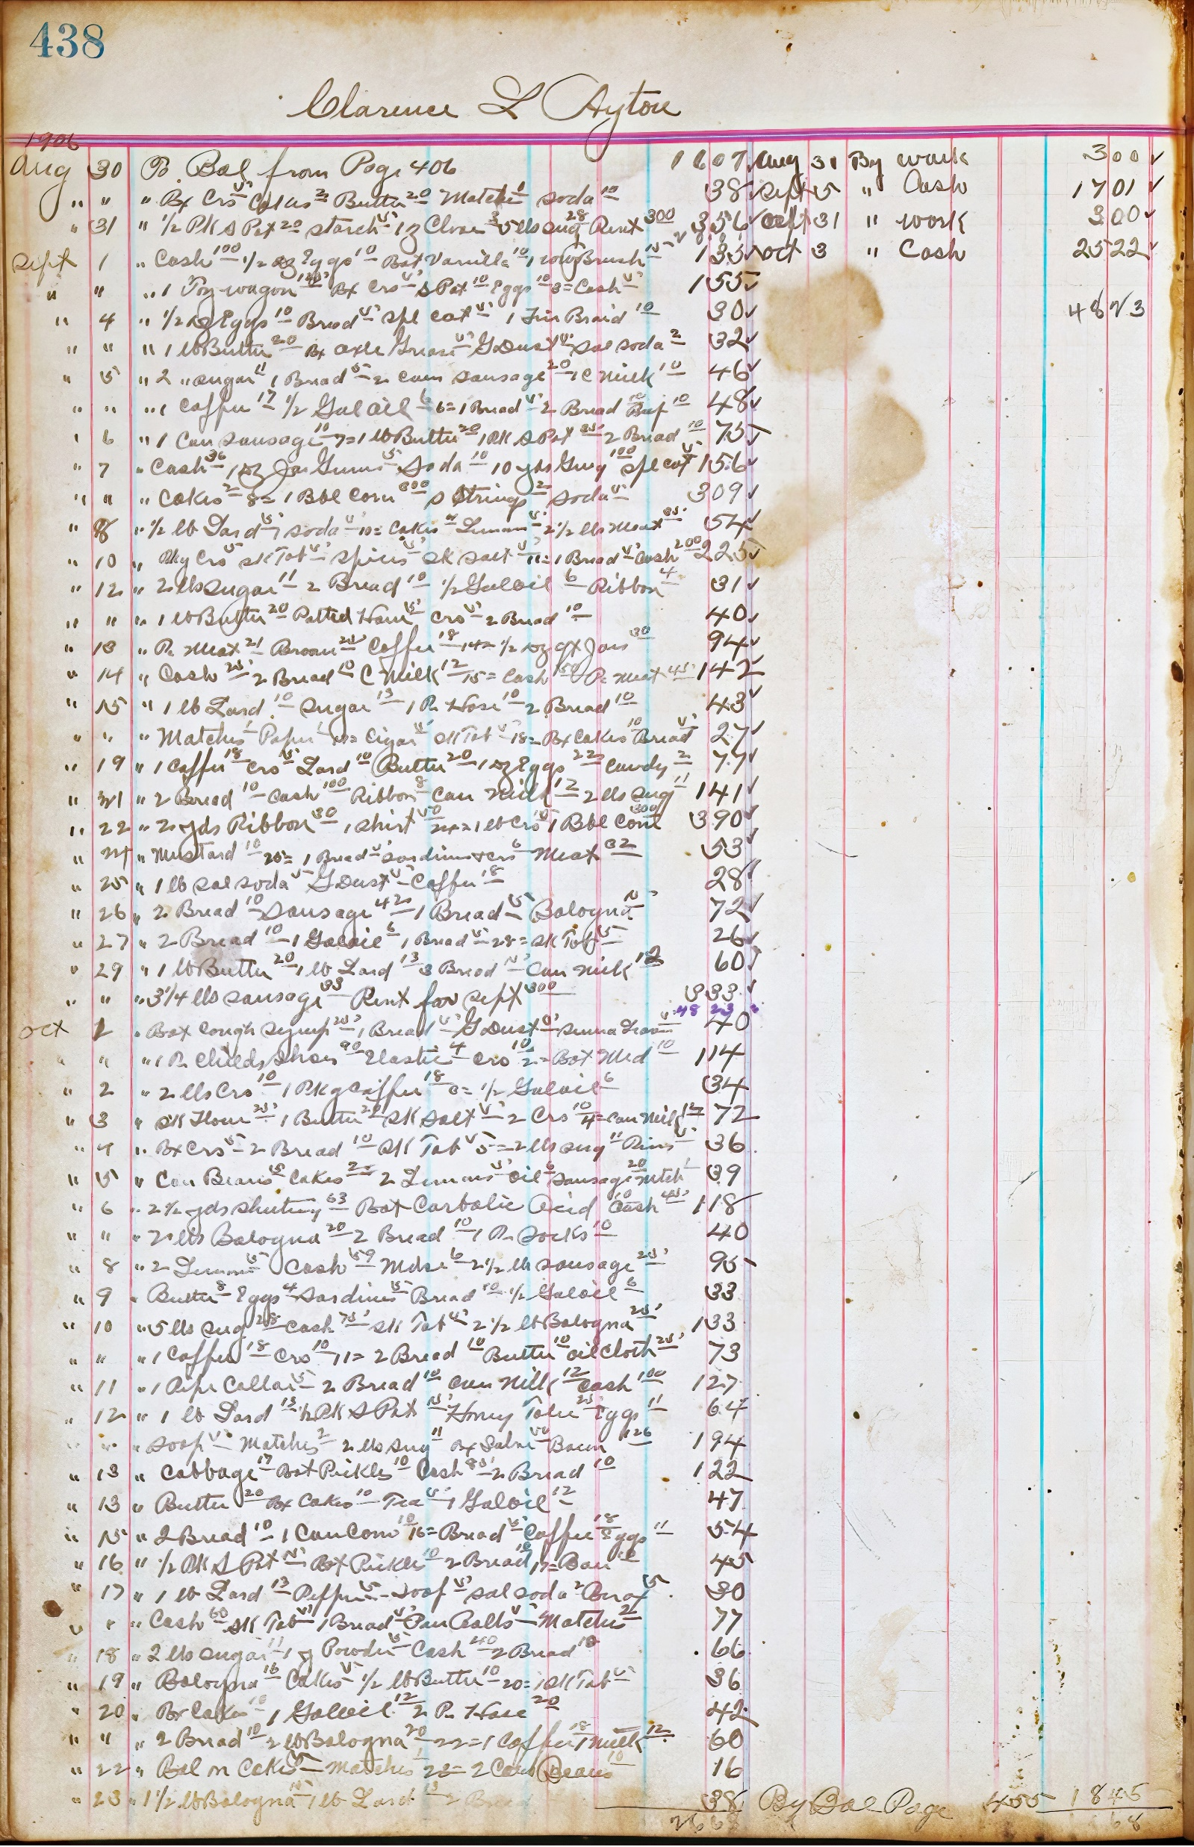
Sample pages in the Boyds store ledger
The jagged handwriting
The loopy handwriting

Slide 4
Research question: what is the most feasible option for transcribing the Boyds store ledger?
Manual transcription
The PyLaia Python library
The Transkribus platform, which runs on the PyLaia Python library
Google Gemini

Slide 5
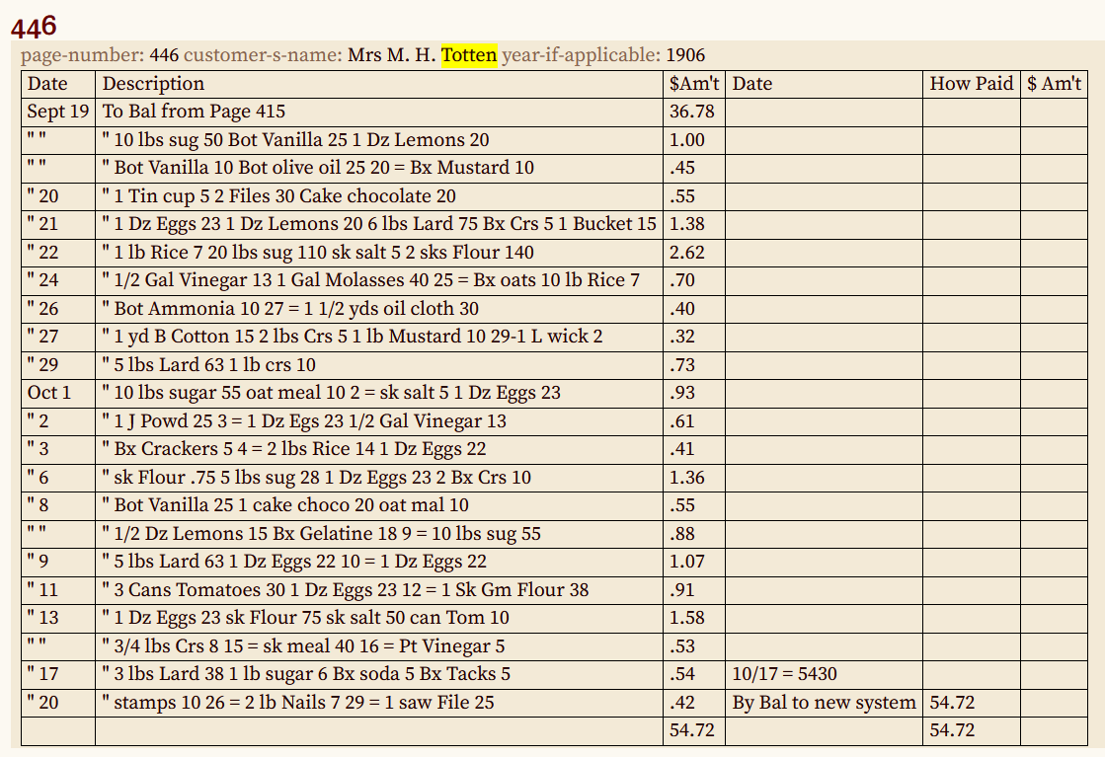
Manual transcription
Images uploaded into From The Page platform using the Sandy Spring Museum’s subscription.
Table format created.
Anyone with a From The Page account can transcribe (crowd-sourcing).
From The Page also has AI transcription (Gemini) as an additional option for subscribers.

Slide 6
PyLaia Python library
PyLaia is a toolkit for Automatic Text Recognition (ATR) and Keyword Spotting (KWS).
Originally developed by 3 members (@jpuigcerver, @mauvilsa, @dmartinalbo) of the Pattern Recognition and Human Language Technology (PRHLT) research center in 2016.
Latest release August 12, 2024.
Latest Python version 3.10.
Trainable models using individual text line images.

Slide 7
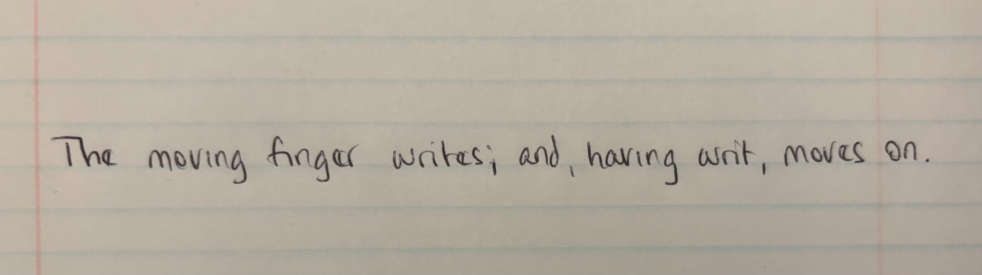
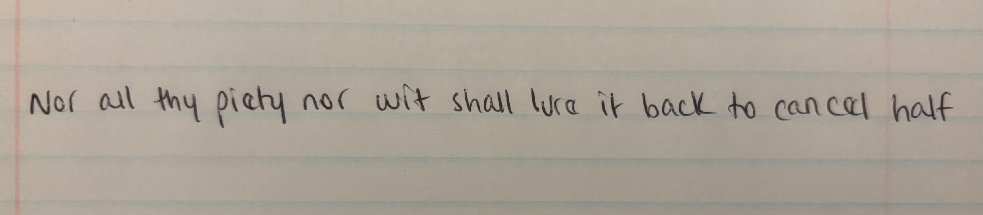
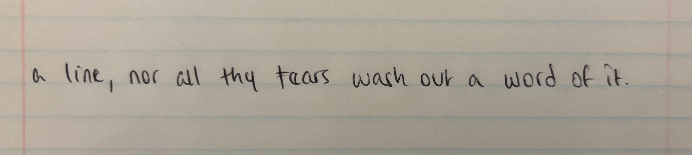
Text line images used to test PyLaia
TRAIN: The moving finger writes; and, having write, moves on.
VALIDATE: Nor all thy piety nor wit shall lure it back to cancel half
TEST: a line, nor all thy tears wash out a word of it.

Slide 8
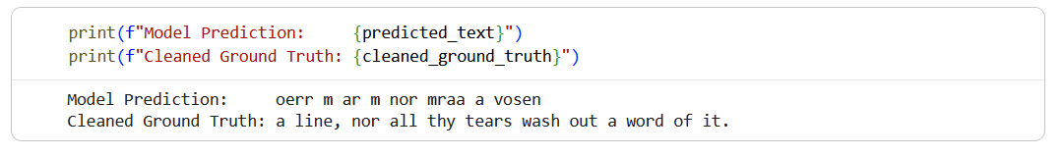
Results using PyLaia
Coding in Google Colab in Python 3.10, using PyLaia documentation and Gemini
Test text: “a line, nor all thy tears wash out a word of it.”
Model trained on train image and validation image: [no result]
Trained model from HuggingFace: “oerr m ar m nor mraa a vosen”

Slide 9
Transkribus
Text recognition, layout detection, AI training platform based on PyLaia Python library.
Built and hosted in Europe by a co-operative.
GDPR compliant.
All data processed and stored on Transkribus-owned servers in Austria.
Data owners’ ownership is maintained.
Requires paid subscription.

Slide 10
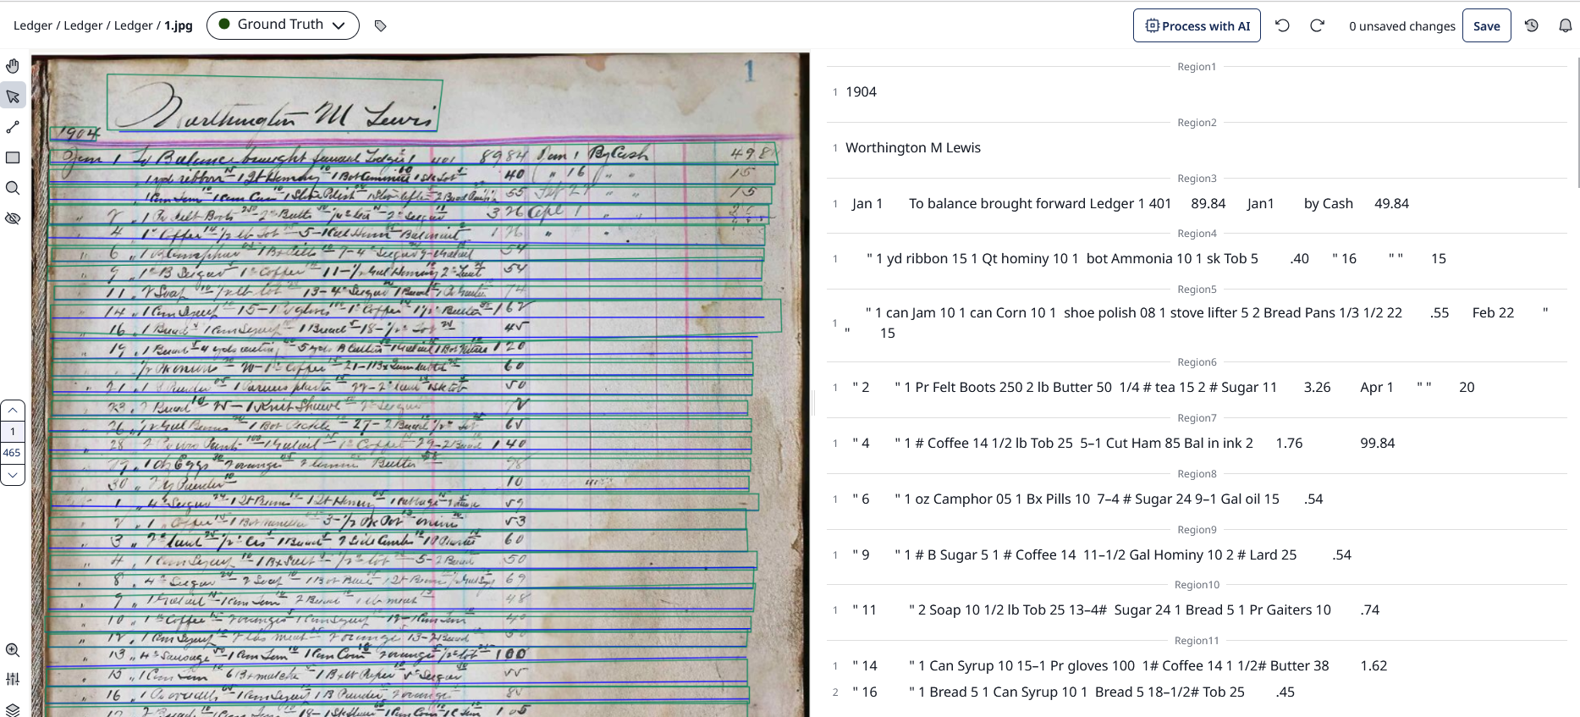
Example of Transkribus page interface

Slide 11
Transkribus text model training on ledger
18 pages manually line-identified and transcribed for the training dataset
90/10 train-test split
Model run duration: 42 minutes, 46 seconds
Number of epochs: 100
Best Character Error Rate (CER): 57.05%
Best Word Error Rate (WER): 76.89%

Slide 12
Approximate comparison of trained Transkribus model vs. manual transcription
Transkribus | Manual transcription
1 | " 1 yd ribbon 15 1 Qt hominy 10 1 bot Ammonia 10 1 sk Tob 5
10 A 1 | " 1 can Jam 10 1 can Corn 10 1 shoe polish 08 1 stove lifter 5 2 Bread Pans 1/3 1/2 22
12 | " 1 Pr Felt Boots 250 2 lb Butter 50 1/4 # tea 15 2 # Sugar 11
" 1 1/ l o 10 1 b s 10 1 a ns 25 .. . | " 1 # Coffee 14 1/2 lb Tob 25 5–1 Cut Ham 85 Bal in ink 2
" 2 5 o 0 1 Gl 15 1 20 a . C . | " 1 oz Camphor 05 1 Bx Pills 10 7–4 # Sugar 24 9–1 Gal oil 15
" "4 o 50 10 1 o 15 2 s 5. | " 1 # B Sugar 5 1 # Coffee 14 11–1/2 Gal Hominy 10 2 # Lard 25

Slide 13
Gemini
Prompt #1 (Gemini 3.6 Flash) | Prompt #2 (Gemini 3.1 Pro)*
Transcribe this handwritten page from a store ledger. The writing has numbers and words. Some of the words are abbreviations. The image is in tabular format. The customer name and the year are at the top. The columns from left to right are month, day, items sold to the customer, total cost of items, month, day, items bought from the customer or customer payment, total amount. | Your task is to accurately transcribe this handwritten historical document, minimizing the CER and WER. Work character by character, word by word, line by line, transcribing the text exactly as it appears on the page. To maintain the authenticity of the historical text, retain spelling errors, grammar, syntax, capitalization, and punctuation as well as line breaks. Transcribe all of the text on the page including headers, footers, marginalia, insertions, page numbers, etc. If insertions or marginalia are present, insert them where indicated by the author (as applicable). In your final response write Transcription: followed only by your transcription.
*Gemini version and prompt based on Mark Humphries, “Gemini 3 Solves Handwriting Recognition and it’s a Bitter Lesson“,
https://generativehistory.substack.com/p/gemini-3-solves-handwriting-recognition, November 25, 2025.

Slide 14
Comparison of Gemini vs manual transcription
Gemini 3.6 Flash, Prompt #1 | Gemini 3.1 Pro, Prompt #2 | Manual transcription
To Balance brought forward Ledger C 401 | To Balance brought forward Ledger 1 401 | To balance brought forward Ledger 1 401
1 yd ribbon 10 1 qt Hominy 12 1 Bot Medicine 15 1 Box tacks 03 | " 1 yd ribbon 10 1 qt Hominy 10 1 Bot Extracts 10 1 shoe lacs 05 40 | " 1 yd ribbon 15 1 Qt hominy 10 1 bot Ammonia 10 1 sk Tob 5
1 Can Corn 12 1 Can Corn 12 1 Bottle Polish 06 Shoe Lifts 25 2 Boxes Pins 10 | " 1 Can Tom 10 1 Can Corn 10 1 Shoe Polish 10 1 Bot lyptis 25 2 Bxul Oinion 10 55 | " 1 can Jam 10 1 can Corn 10 1 shoe polish 08 1 stove lifter 5 2 Bread Pans 1/3 1/2 22
1 Pr felt Boots 2.50 2 pr Socks 50 pr Leggins 25 2 pr Leggins 50 | " 1 Pr child Boots 2.50 2s Butts 50 prs buts 50 2# sugar 14 | " 1 Pr Felt Boots 250 2 lb Butter 50 1/4 # tea 15 2 # Sugar 11
1 # Coffee 14 1/2 lb Tob 25 5–14 Match Boxes Balmint 37 | " 1# Coffee 14 1/2 lb Tob 25 - 5 - 1 Gal Kerosene 15 Bal mdse 122 | " 1 # Coffee 14 1/2 lb Tob 25 5–1 Cut Ham 85 Bal in ink 2

Slide 15
Some conclusions
PyLaia by itself
Infeasible because it requires one image per line.
The Boyds store ledger images are one image per page.
Transkribus
Model training might work better with more training images. The documentation advises 25-50.
The user has to learn how to use Transkribus via documentation, training videos, and trial and error.
Cost limitations: approximately 1 credit per page transcription. However, running the training models does not cost.
Data difficulty: the Boyds store ledger images are kind of tabular. Not purely linear, but also not regularly either area format (e.g., a form) or table format.

Slide 16
More conclusions
Gemini
API needed.
Data ownership – the free limited API uses the data to train the LLM.
Cost – the unlimited API, which does not use the data to train the LLM, costs [something].
Transcription results are plausible but often incorrect.
Gemini has not (yet) solved handwriting recognition.
Manual
Manual transcription by a knowledgeable transcriber is the most accurate method.
Manual editing will be needed regardless of the transcription method used.
Crowd-sourcing does not necessarily scale up, but may be the most feasible option for one document for the Boyds Historical Society.

Slide 17
Next steps
For this transcription project:
More manual transcription.
More ground truth images for training the Transkribus model.
Better preparation of ground truth images based on how PyLaia works.
There is a need for a handwriting transcription option that is:
Accurate.
Transparent.
Easy to use.
Maintains data ownership.

Slide 18
Questions?

